Slide 1


Introduction to Jupyter Notebook
AHMED OLANREWAJU
UNIVERSITY OF IBADAN

Slide 2
HISTORY
Project Jupyter is a nonprofit organization created to "develop open-source software, open-standards, and services for interactive computing across dozens of programming languages." Spun-off from IPython in 2014 by Fernando Pérez.
Project Jupyter supports execution environments in several dozen languages.

Slide 3



HISTORY
Project Jupyter's name is a reference to the three core programming languages supported by Jupyter, which are Julia, Python and R, and also an homage to Galileo's notebooks recording the discovery of the moons of Jupiter.
Project Jupyter has developed and supported the interactive computing products Jupyter Notebook, Jupyter Hub, and Jupyter Lab, the next-generation version of Jupyter Notebook.

Slide 4
Jupyter Notebook
What is the Jupyter Notebook?
Notebook document
Jupyter Notebook App
kernel
Notebook Dashboard
References

Slide 5
Notebook document
Notebook documents (or “notebooks”, all lower case) are documents produced by the Jupyter Notebook App, which contain both computer code (e.g. python) and rich text elements (paragraph, equations, figures, links, etc…). Notebook documents are both human-readable documents containing the analysis description and the results (figures, tables, etc..) as well as executable documents which can be run to perform data analysis.

Slide 6
Jupyter Notebook App
The Jupyter Notebook App is a server-client application that allows editing and running notebook documents via a web browser. The Jupyter Notebook App can be executed on a local desktop requiring no internet access (as described in this document) or can be installed on a remote server and accessed through the internet.
n addition to displaying/editing/running notebook documents, the Jupyter Notebook App has a “Dashboard” (Notebook Dashboard), a “control panel” showing local files and allowing to open notebook documents or shutting down their kernels.

Slide 7
kernel
A notebook kernel is a “computational engine” that executes the code contained in a Notebook document. The ipython kernel, referenced in this guide, executes python code. Kernels for many other languages exist (official kernels).
When you open a Notebook document, the associated kernel is automatically launched. When the notebook is executed (either cell-by-cell or with menu Cell -> Run All), the kernel performs the computation and produces the results. Depending on the type of computations, the kernel may consume significant CPU and RAM. Note that the RAM is not released until the kernel is shut-down.

Slide 8
Notebook Dashboard
The Notebook Dashboard is the component which is shown first when you launch Jupyter Notebook App. The Notebook Dashboard is mainly used to open notebook documents, and to manage the running kernels (visualize and shutdown).
The Notebook Dashboard has other features similar to a file manager, namely navigating folders and renaming/deleting files.

Slide 9
Installation
Step 0: The browser
Step “zero” consists in installing a modern standard-compliant browser. Either Mozilla Firefox or Google Chrome will work well. Try to avoid MS Explorer.

Slide 10
Installation
Step 1: Installation
The easiest way to install the Jupyter Notebook App is installing a scientific python distribution which also includes scientific python packages. The most common distribution is called Anaconda:
Download Anaconda Distribution (a few 100MB), Python 3, 64 bits.
Install it using the default settings for a single user.

Slide 11
Running the Jupyter Notebook
Launching Jupyter Notebook App
The Jupyter Notebook App can be launched by clicking on the Jupyter Notebook icon installed by Anaconda in the start menu (Windows) or by typing in a terminal (cmd on Windows):
jupyter notebook

Slide 12
Running the Jupyter Notebook
This will launch a new browser window (or a new tab) showing the Notebook Dashboard, a sort of control panel that allows (among other things) to select which notebook to open.
When started, the Jupyter Notebook App can access only files within its start-up folder (including any sub-folder). No configuration is necessary if you place your notebooks in your home folder or subfolders. Otherwise, you need to choose a Jupyter Notebook App start-up folder which will contain all the notebooks.

Slide 13

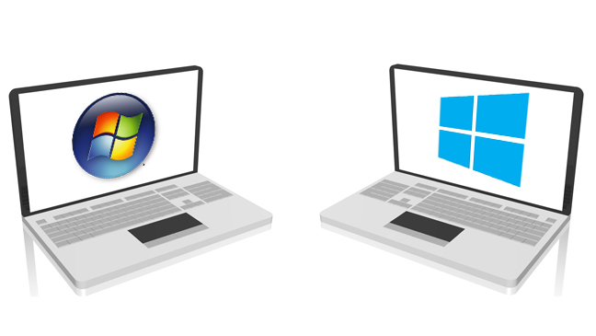
Change Jupyter Notebook startup folder (Windows)
Copy the Jupyter Notebook launcher from the menu to the desktop.
Right click on the new launcher and change the Target field, change %USERPROFILE% to the full path of the folder which will contain all the notebooks.
Double-click on the Jupyter Notebook desktop launcher (icon shows [IPy]) to start the Jupyter Notebook App. The notebook interface will appear in a new browser window or tab. A secondary terminal window (used only for error logging and for shut down) will be also opened.

Slide 14
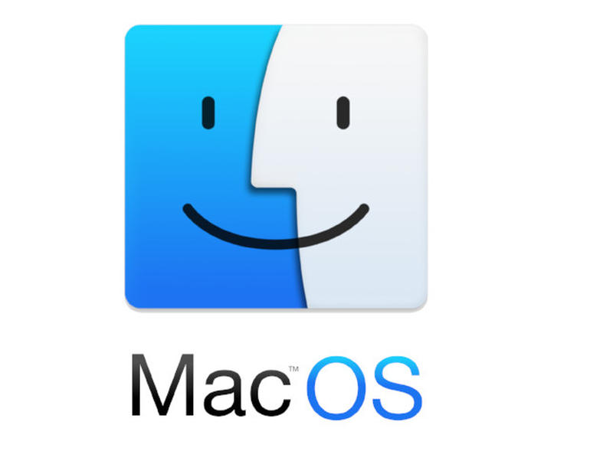
Change Jupyter Notebook startup folder (Mac OS)
Click on spotlight, type terminal to open a terminal window.
Enter the startup folder by typing cd /some_folder_name.
Type jupyter notebook to launch the Jupyter Notebook App
The notebook interface will appear in a new browser window or tab.

Slide 15
Shut down the Jupyter Notebook App
Closing the browser (or the tab) will not close the Jupyter Notebook App. To completely shut it down you need to close the associated terminal.
In more detail, the Jupyter Notebook App is a server that appears in your browser at a default address (http://localhost:8888). Closing the browser will not shut down the server. You can reopen the previous address and the Jupyter Notebook App will be redisplayed.

Slide 16
Close a notebook: kernel shut down
When a notebook is opened, its “computational engine” (called the kernel) is automatically started. Closing the notebook browser tab, will not shut down the kernel, instead the kernel will keep running until is explicitly shut down.
To shut down a kernel, go to the associated notebook and click on menu File -> Close and Halt. Alternatively, the Notebook Dashboard has a tab named Running that shows all the running notebooks (i.e. kernels) and allows shutting them down (by clicking on a Shutdown button).

Slide 17
Executing a notebook
Download the notebook you want to execute and put it in your notebook folder (or a sub-folder of it).
You can run the notebook document step-by-step (one cell a time) by pressing shift + enter.
You can run the whole notebook in a single step by clicking on the menu Cell -> Run All.
To restart the kernel (i.e. the computational engine), click on the menu Kernel -> Restart. This can be useful to start over a computation from scratch (e.g. variables are deleted, open files are closed, etc…).

Slide 18
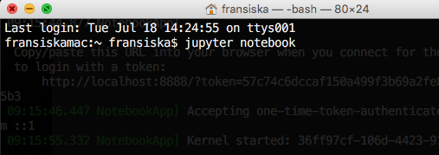
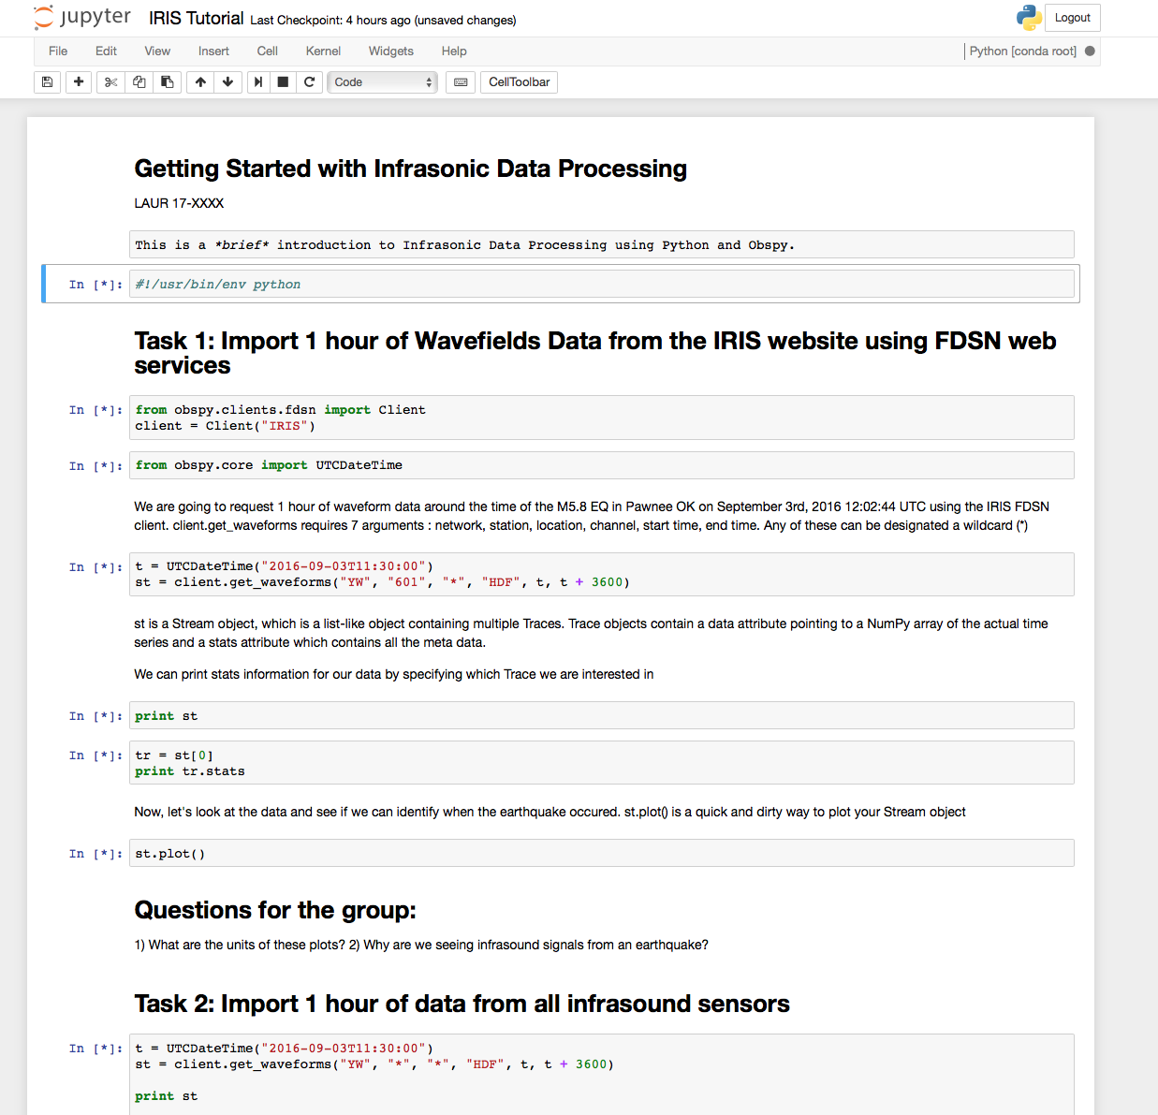
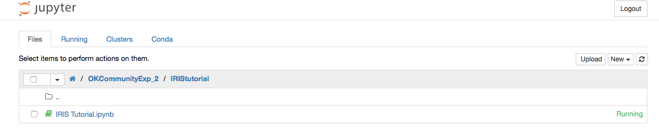
Introduction to Jupyter
“The Jupyter Notebook is an open-source web application that allows you to create and share documents that contain live code, equations, visualizations and explanatory test”

Slide 19
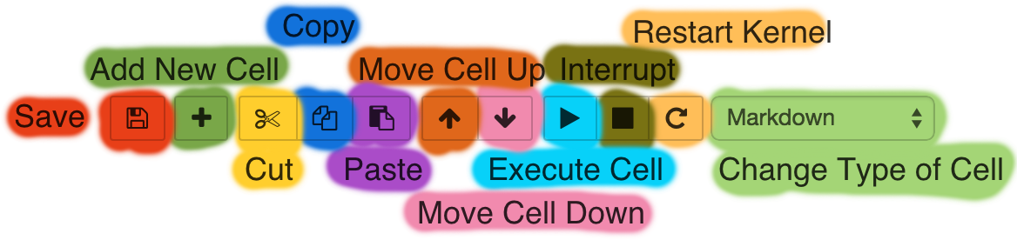
Jupyter Toolbar and Commands
Shift + Enter: Execute cell and jump to the next cell
Ctrl + Enter: Execute cell and don’t jump to the next cell
If code execution is not responding anymore: Restart kernel (cache of previously assigned variables gets emptied)

Slide 20

JUPYTER NOTEBOOK IN THE CLOUD

